Slide 1
Developing a web application to improve communication at a software company.
ITRI671 – Research project
Student: Enrico Dreyer (31210783)
Supervisor: Dr. Suné Van Der Linde
Co-supervisor: Mr. Luke Coetzee

Slide 2
Introduction
Developing a web application to improve communication at a software company.
Goal: To develop a web application that can be used to enhance communication between developers and management at a South African software development company.
The system will allow project software developers to have access to important information with ease.
Outcome: A web application that enhances communication.

Slide 3
Key concepts
Developing a web application to improve communication at a software company
Key concept: Improve communication at a software company.
Second key concept: Different communication methods used in the industry.

Slide 4
Research problem
Developing a web application to improve communication at a software company
As programmers, we want to keep the most important tabs open but lack the number of screens needed to achieve this.
Developers are not regularly on their phones to read messages, making it harder for important messages to reach the team or developer.
This study proposes to develop an artifact that will allow project managers and project developers to have access to a way of communicating, and to access important information during the day with ease.

Slide 5
Objectives
Developing a web application to improve communication at a software company
Primary objective:
The primary objective is to develop a web application for a South African software development company that allows for easy access to important communication relating to specific projects.

Slide 6
Objectives (cont.)
Developing a web application to improve communication at a software company
Secondary objectives:
Theoretical objectives – a literature review is required for:
Gain knowledge of design science research to guide the development of an artifact.
To identify commonly used communication methods in industry.
Empirical objective:
To collect and analyze qualitative data in the form of an interview in order to understand what people in the software development industry need to make communication easier.

Slide 7
Research paradigm and method
Developing a web application to improve communication at a software company
A Design Science Research paradigm is used. An artefact was used to achieve the aims and objectives.
Vaishnavi Process Model is used to develop the artefact.
Explore the needs for different communication methods.
The qualitative data gathering technique that will be used in this study is a semi-structured interview.

Slide 8
Data collection and analysis
Developing a web application to improve communication at a software company
Data collection:
Semi-structured interview.
Data analysis:
Open coding analysis, more specific line-by-line.

Slide 9
Ethical considerations
Developing a web application to improve communication at a software company
Voluntary
Informed consent
Confidential
NWU ethical process

Slide 10
Participant
Developing a web application to improve communication at a software company
A project manager that has experience in the industry.
He was just as exited as I was.

Slide 11
Data collection
Developing a web application to improve communication at a software company
Semi-structured interviews
Face-to-face
Consent form
Conversation about features that would help them out.

Slide 12
Data analysis
Developing a web application to improve communication at a software company
Used open coding as analysis technique.
Common requirements and specifications:
Easy Communication method
Improve Productivity
Artefact should focus on communication between employees and about their project.
Create a relaxed environment.
The user experience comes first.

Slide 13
Findings
Developing a web application to improve communication at a software company
Easy Communication method:
Combining different communication methods: For the Artefact communication methods that was focused on was instant messages and Issue queues.
Improve Productivity:
Project overview, a member of a team will be able to see an overview of their team. Users are always aware of what they whole team is busy with.

Slide 14
Findings (cont.)
Developing a web application to improve communication at a software company
Artefact should focus on communication between employees and about their project:
In this artefact, an “Activities” feature was added. The Activities feature provides information on the backlog of the project.
An Analytics page was added to give important information on the project.
Create a relaxed environment:
A calendar feature was developed for the artefact. This creates a more flexible way of planning the project and everyone in the team can contribute to events.
The user experience comes first:
By using pre-emptive dialog, users will make minimal errors when working with the artefact. For example, putting each feature in its own tab.

Slide 15
Limitations and future research
Developing a web application to improve communication at a software company
Limitations:
More participants
More interviews
Future research:
More Features
Full system and not limited to Honours degree scope.

Slide 16
Thank you! Any questions before I show the artefact?
Developing a web application to improve communication at a software company

Slide 17
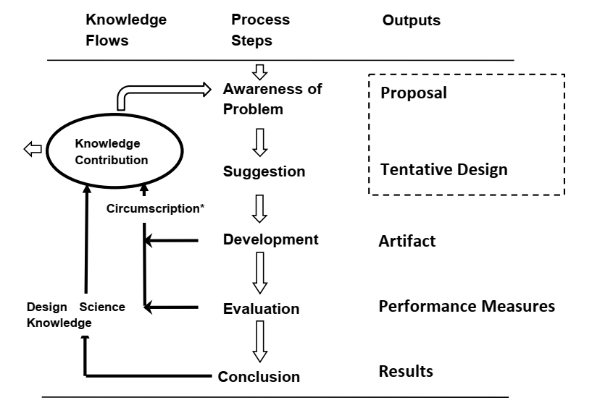
Vaishnavi Process Model
Developing a web application to improve communication at a software company
Process Steps:
Awareness of problem: The objective is to improve the communication between project managers and project developers (Chapter 1 + 2 + 3)
Suggestion: The interview (Chapter 4)
Development: The actual development (Chapter 5)
Evaluation: Did it adapt to the industry, is everyone happy? (project demo)
Conclusion: Did it meet the requirements? (Chapter 6)

Slide 18
Features:
Developing a web application to improve communication at a software company
Analytics Page
Chat
Calendar
To Do
My Team
Activities

Slide 19
What did I use?
Developing a web application to improve communication at a software company
Hosting on Azure:
Hosted the Database
Created my own project (DevOps)
Hosted my repository
Languages, programs and frameworks:
Html
Javascript
Vue (binding framework)
SCSS
.Net Core 3.1
Fork (repository)
Azure Data studio (DBMS)

Slide 20

Let's get to it!
Developing a web application to improve communication at a software company

